Slide 1
Zipcar - Car Rental Service
Submitted By:
Alaukika Diwanji (014547013) Amit Garg (014541072) Nachiket Trivedi (014544933) Sarthak Jain (014508013)

Slide 2
Introduction
An online car-rental service allowing the user to make car reservations, modifying and managing them.
The system has two main roles:
1.) Driver
2.) Admin
The Driver can book a car, browse vehicles and manage bookings.
The Admin will take manage the locations, vehicle types, pricing and vehicles.

Slide 3
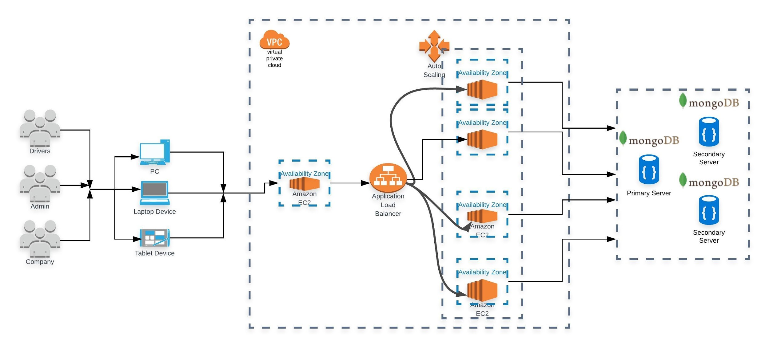
Architecture

Slide 4
Features
Driver
Register new drivers with 6-month membership
Browse Vehicles and prices
Book Vehicles according to selected date, time, location.
Manage bookings
Terminate/ Renew Membership
Admin
Register Admin with company codes.
Add/ Delete Locations
Add/ Edit/ Delete Vehicle Types
Add/ Edit/ Delete Vehicles
Change Vehicle Locations
Terminate Membership of users

Slide 5
Software Engineering Principles
Weekly SCRUM Meetings
XP Values learned:
Feedback
Mutual Respect
Communication
Courage

Slide 6
Work Partition
Alaukika
Login/ Signup
Manage Vehicles
Manage Locations
Manage Vehicle Types
Manage Users
*Frontend
Amit
Browse Rental Location
Browse Vehicles
Past Booking
AWS Deployment
Membership Management
Nachiket
Login/ Signup
Manage Vehicles
Manage Locations
Manage Vehicle Types
Manage Users
*Backend
Sarthak
Create Booking
Start Booking
Ongoing Booking
End Booking
AWS Deployment
Membership Management

Slide 7
ThankYou

